Slide 1

SOCIO

Slide 2
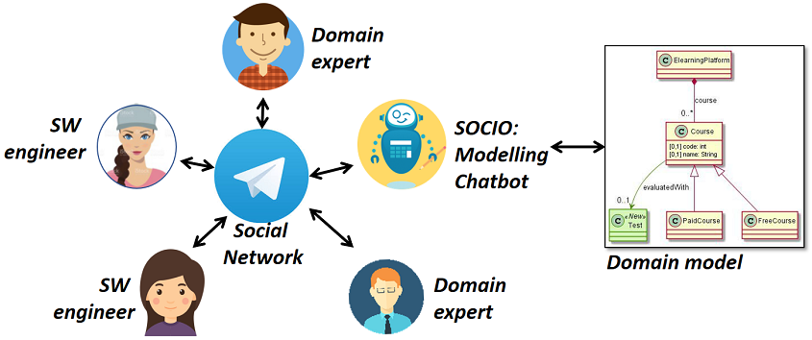

Slide 3

Crear un grupo de Telegram
@ModellingBot

Slide 4
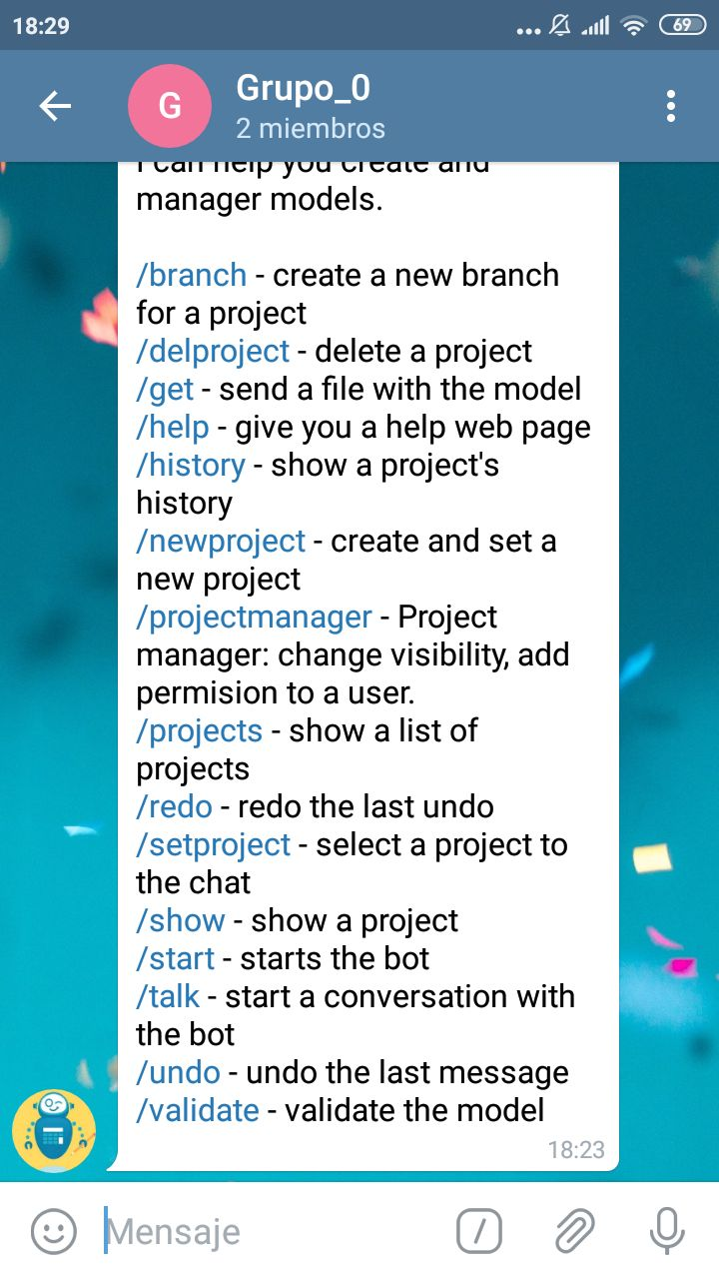
/start
Muestra todos los comando

Slide 5
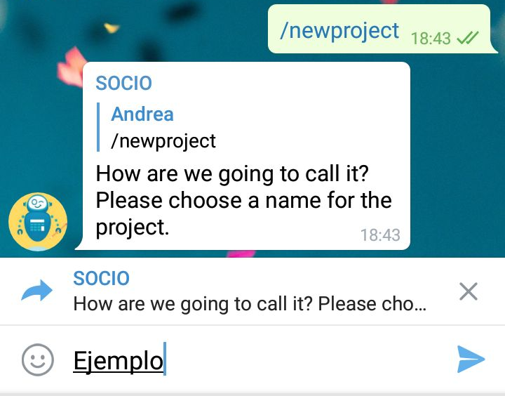
/newproject
Nombre

Slide 6
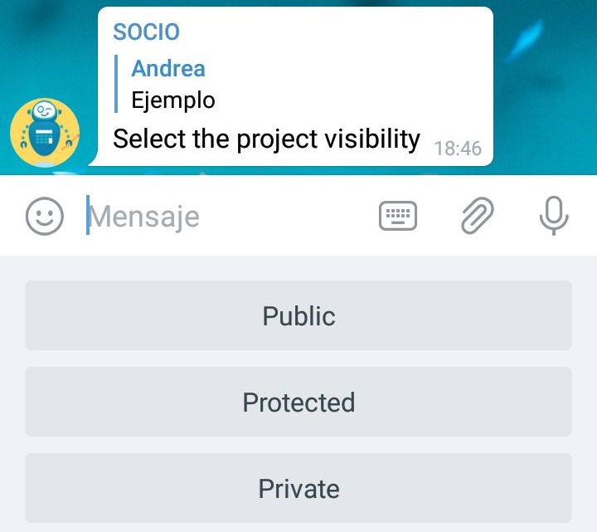
Visibilidad

Slide 7
/delproject
/projects
/setproject
/projectmanager

Slide 8
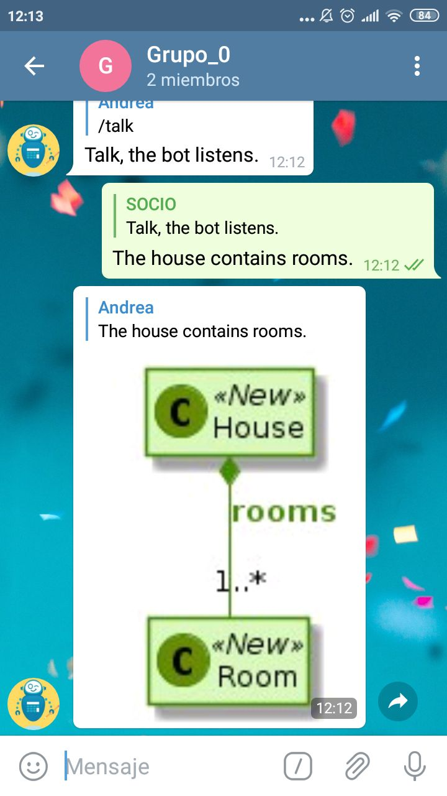
/talk
The house contains rooms.

Slide 9
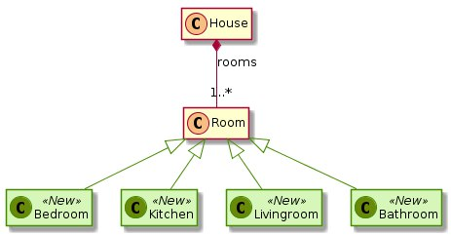
/talk Bathroom, bedroom, kitchen and livingroom are rooms.

Slide 10
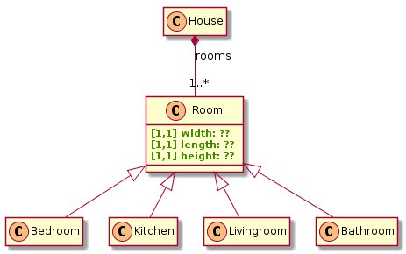
/talk Add width, length and height in room.

Slide 11
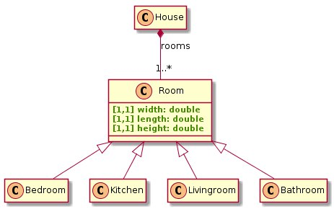
/talk Width, length and height in room are double.

Slide 12
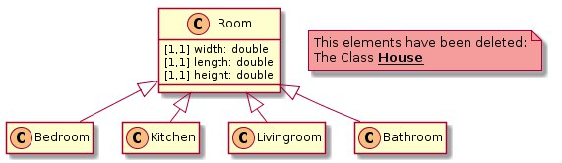
/talk Remove home.

Slide 13
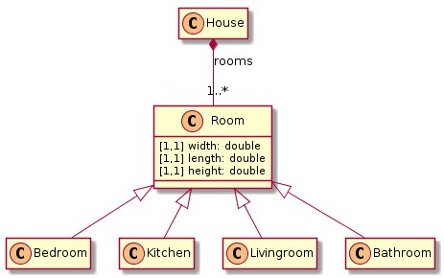
/undo Ctrl+Z

Slide 14
/redo Ctrl+Y

Slide 15
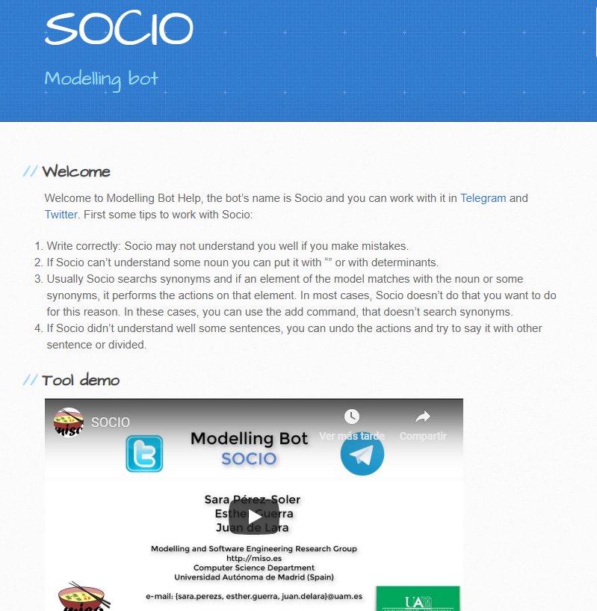
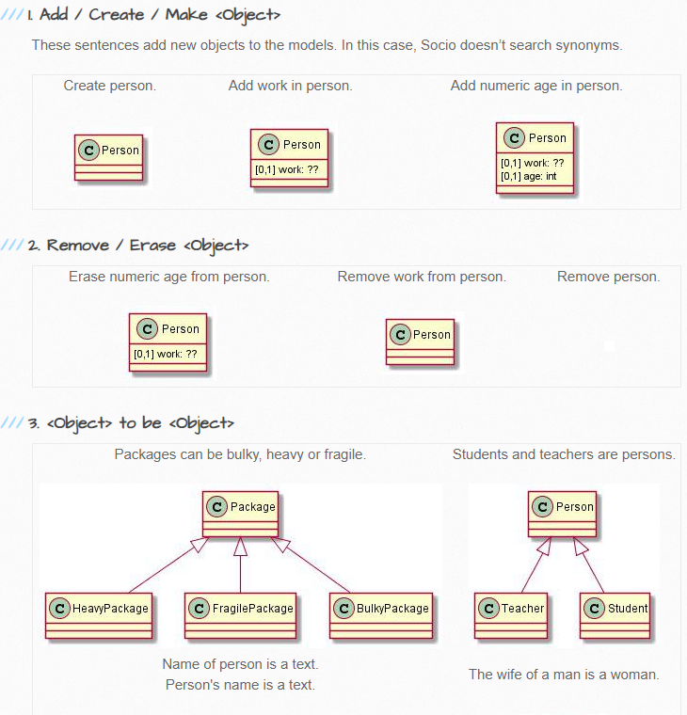
/help
https://saraperezsoler.github.io/ModellingBot/

Slide 16
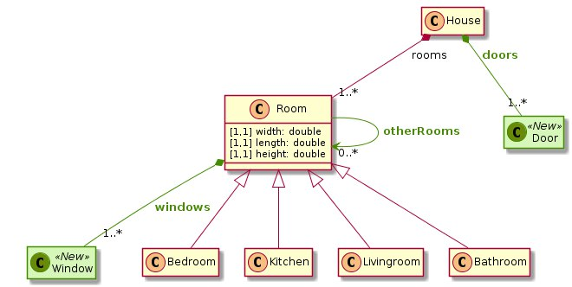
/talk The room may have other rooms.
The room contains windows and
the house includes doors.

Slide 17
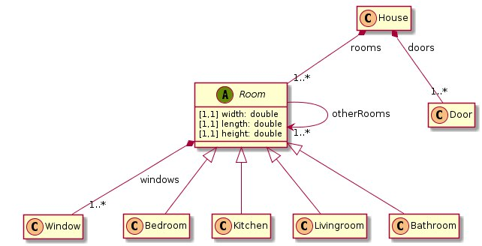
/talk Room is abstract.

Slide 18
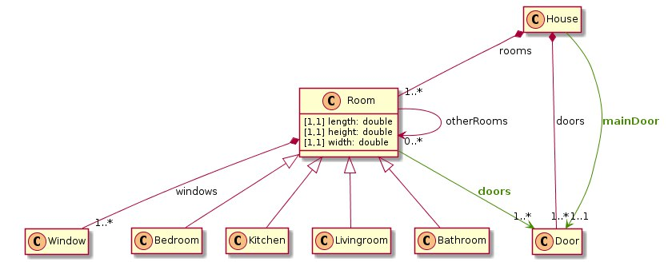
/talk The rooms have doors.
The house has a main door.
/talk Room is abstract.

Slide 19
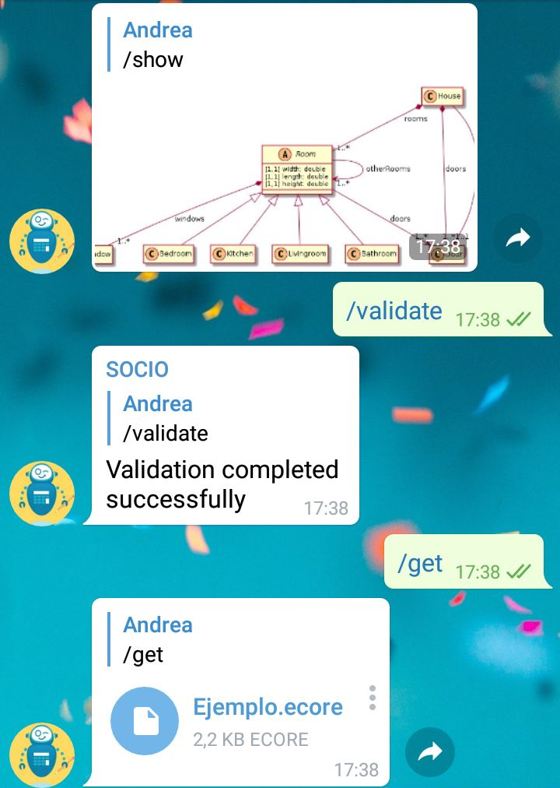
/show
/validate
/get

Slide 20
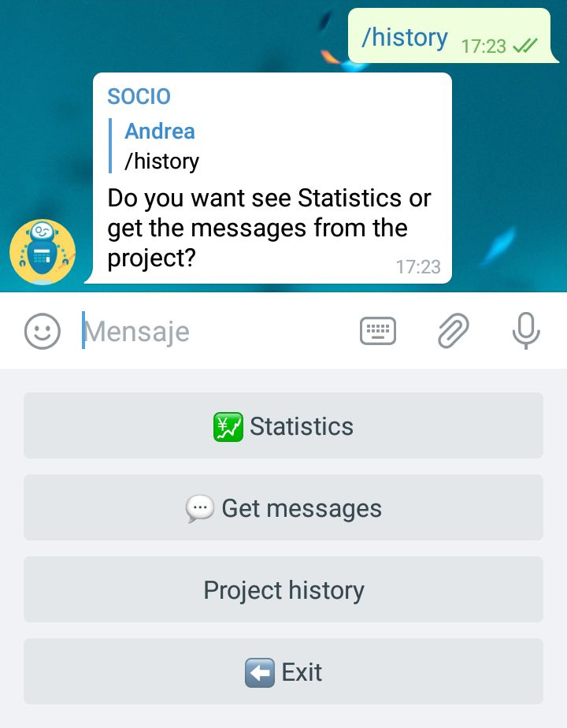
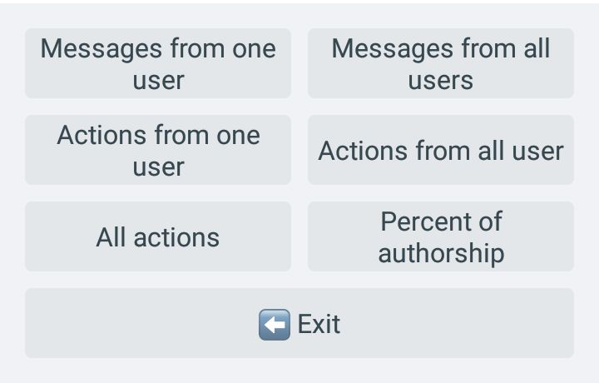
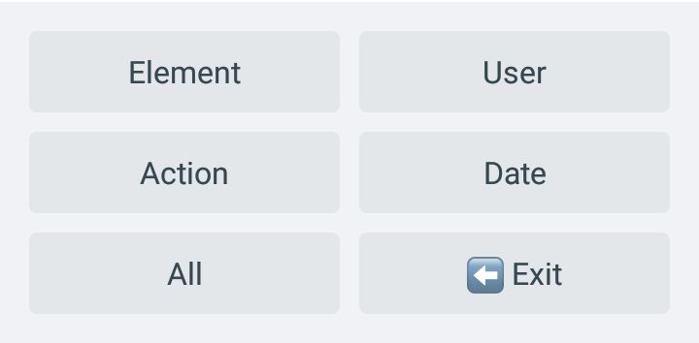
/history

Slide 21
TAREA

Slide 22
Grupo de Telegram
Integrantes:
@ModellingBot
@Rancyy
Nombre: EQUIPOX_ECUADOR_SOCIO

Slide 23
/newproject
Nombre: EQUIPOX
Visibilidad: Público
No se puede hablar, solo
por Telegram.
30 minutos

